Slide 1
Introduction to Differential Equations - Lecture 14
Fei Qi
Email: fei.qi@du.edu
Website: https://feiqimath.github.io

Slide 2
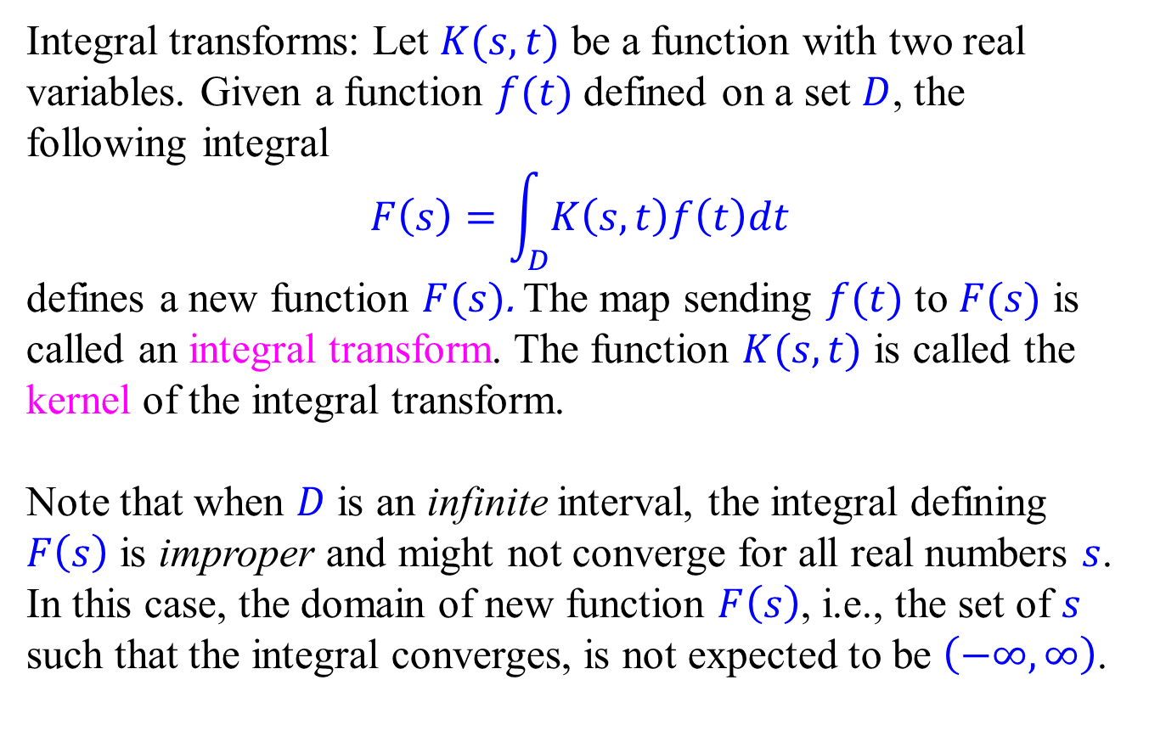
Integral transform
Integral transforms: Let $K(s,t)$ be a function with two real variables. Given a function $f(t)$ defined on a set $D$, the following integral
$$F\left(s\right)=\int_{D}{K\left(s,t\right)f\left(t\right)dt}$$
defines a new function $F(s)$. The map sending $f(t)$ to $F(s)$ is called an integral transform. The function $K(s,t)$ is called the kernel of the integral transform.
Note that when $D$ is an infinite interval, the integral defining $F\left(s\right)$ is improper and might not converge for all real numbers $s$. In this case, the domain of new function $F\left(s\right)$, i.e., the set of $s$ such that the integral converges, is not expected to be $\left(−∞, ∞\right)$.

Slide 3
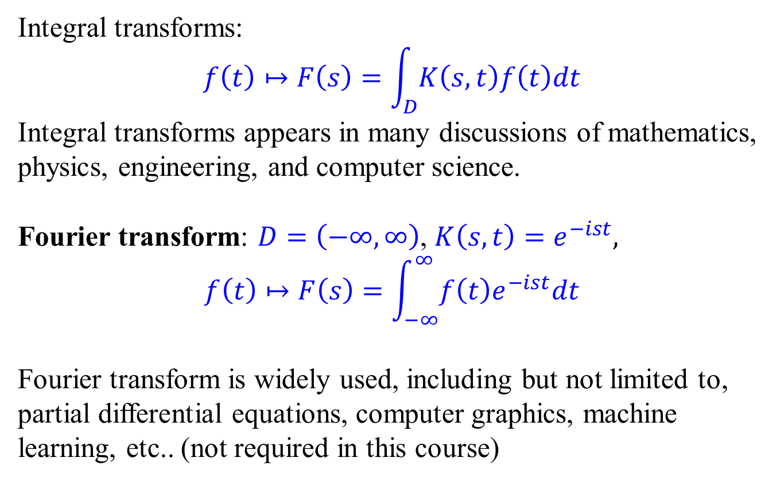
Fourier transform
Integral transforms:
$$f\left(t\right)↦F\left(s\right)=\int_{D}{K\left(s,t\right)f\left(t\right)dt}$$
Integral transforms appears in many discussions of mathematics, physics, engineering, and computer science.
Fourier transform: $D=\left(−∞, ∞\right)$, $K\left(s,t\right)=e^{−ist},$
$$f\left(t\right)↦F\left(s\right)=\int_{−∞}^{∞}{f\left(t\right)e^{−ist}dt}$$
Fourier transform is widely used, including but not limited to, partial differential equations, computer graphics, machine learning, etc.. (not required in this course)
complex function

Slide 4
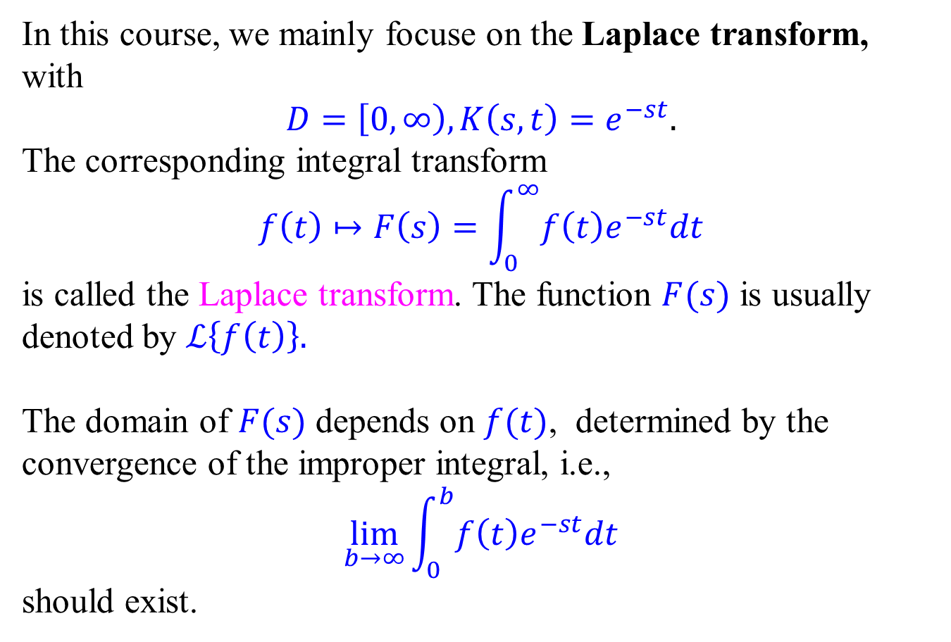
Laplace transform
In this course, we mainly focuse on the Laplace transform, with $$D=\left[0,∞\right), K\left(s,t\right)=e^{−st}.$$
The corresponding integral transform
$$f\left(t\right)↦F\left(s\right)=\int_{0}^{∞}{f\left(t\right)e^{−st}dt}$$
is called the Laplace transform. The function $F(s)$ is usually denoted by $ℒ\left\{f\left(t\right)\right\}.$
The domain of $F(s)$ depends on $f(t)$, determined by the convergence of the improper integral, i.e.,
$$\lim_{b→∞}{\int_{0}^{b}{f\left(t\right)e^{−st}dt}}$$
should exist.

Slide 5
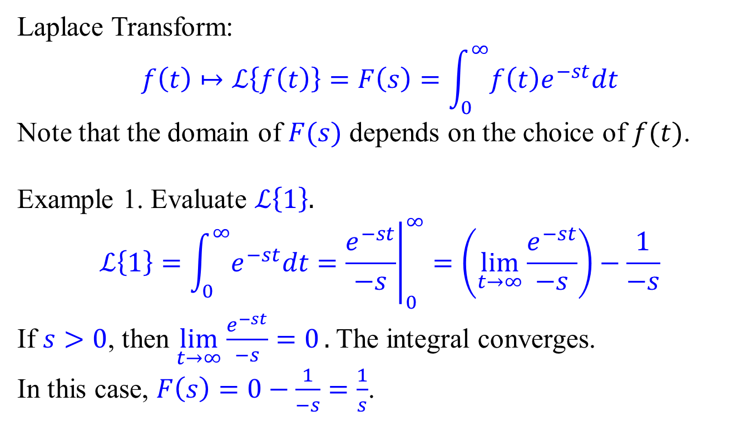
Examples of Laplace transforms
Laplace Transform:
$$f\left(t\right)↦ℒ\left\{f\left(t\right)\right\}=F\left(s\right)=\int_{0}^{∞}{f\left(t\right)e^{−st}dt}$$
Note that the domain of $F(s)$ depends on the choice of $f(t)$.
Example 1. Evaluate $ℒ\left\{1\right\}.$
$$ℒ\left\{1\right\}=\int_{0}^{∞}{e^{−st}dt}={\left.\frac{e^{−st}}{−s}\right|}_{0}^{∞}=（\lim_{t→∞}{\frac{e^{−st}}{−s}}）−\frac{1}{−s}$$
If $s>0$, then $\lim_{t→∞}{\frac{e^{−st}}{−s}=0}.$ The integral converges. In this case, $F\left(s\right)=0−\frac{1}{−s}=\frac{1}{s}$.

Slide 6
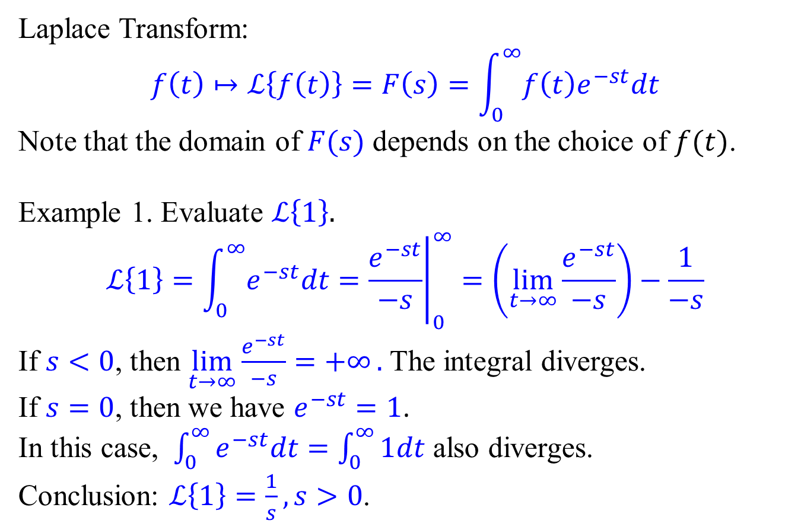
Examples of Laplace transforms
Laplace Transform:
$$f\left(t\right)↦ℒ\left\{f\left(t\right)\right\}=F\left(s\right)=\int_{0}^{∞}{f\left(t\right)e^{−st}dt}$$
Note that the domain of $F(s)$ depends on the choice of $f(t)$.
Example 1. Evaluate $ℒ\left\{1\right\}.$
$$ℒ\left\{1\right\}=\int_{0}^{∞}{e^{−st}dt}={\left.\frac{e^{−st}}{−s}\right|}_{0}^{∞}=（\lim_{t→∞}{\frac{e^{−st}}{−s}}）−\frac{1}{−s}$$
If $s<0$, then $\lim_{t→∞}{\frac{e^{−st}}{−s}=+∞}.$ The integral diverges. If $s=0$, then we have $e^{−st}=1$.
In this case, $\int_{0}^{∞}{e^{−st}dt}=\int_{0}^{∞}{1dt}$ also diverges.
Conclusion: $ℒ\left\{1\right\}=\frac{1}{s}, s>0$.

Slide 7
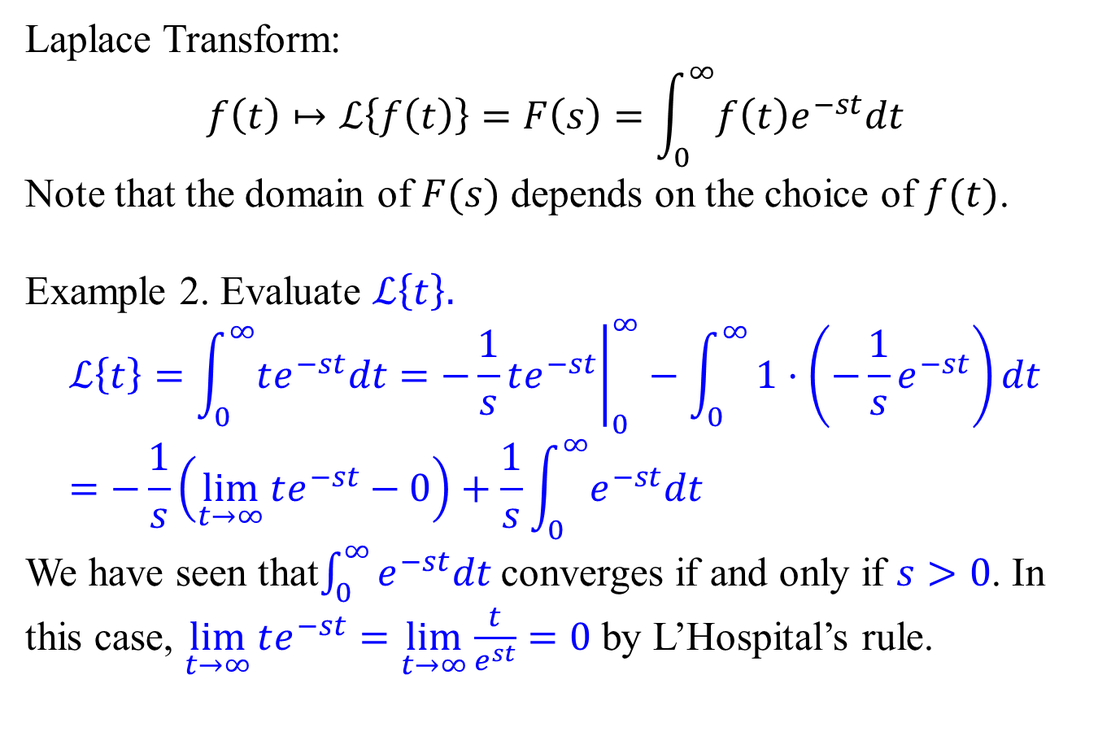
Examples of Laplace transforms
Laplace Transform:
$$f\left(t\right)↦ℒ\left\{f\left(t\right)\right\}=F\left(s\right)=\int_{0}^{∞}{f\left(t\right)e^{−st}dt}$$
Note that the domain of $F(s)$ depends on the choice of $f(t)$.
Example 2. Evaluate $ℒ\left\{t\right\}.$
$$ℒ\left\{t\right\}=\int_{0}^{∞}{te^{−st}dt}={\left.−\frac{1}{s}te^{−st}\right|}_{0}^{∞}−\int_{0}^{∞}{1⋅\left(−\frac{1}{s}e^{−st}\right)dt} \\ =−\frac{1}{s}\left(\lim_{t→∞}{te^{−st}}−0\right)+\frac{1}{s}\int_{0}^{∞}{e^{−st}dt}$$
We have seen that$\int_{0}^{∞}{e^{−st}dt}$ converges if and only if $s>0$. In this case, $\lim_{t→∞}{te^{−st}}=\lim_{t→∞}{\frac{t}{e^{st}}}=0$ by L’Hospital’s rule.

Slide 8
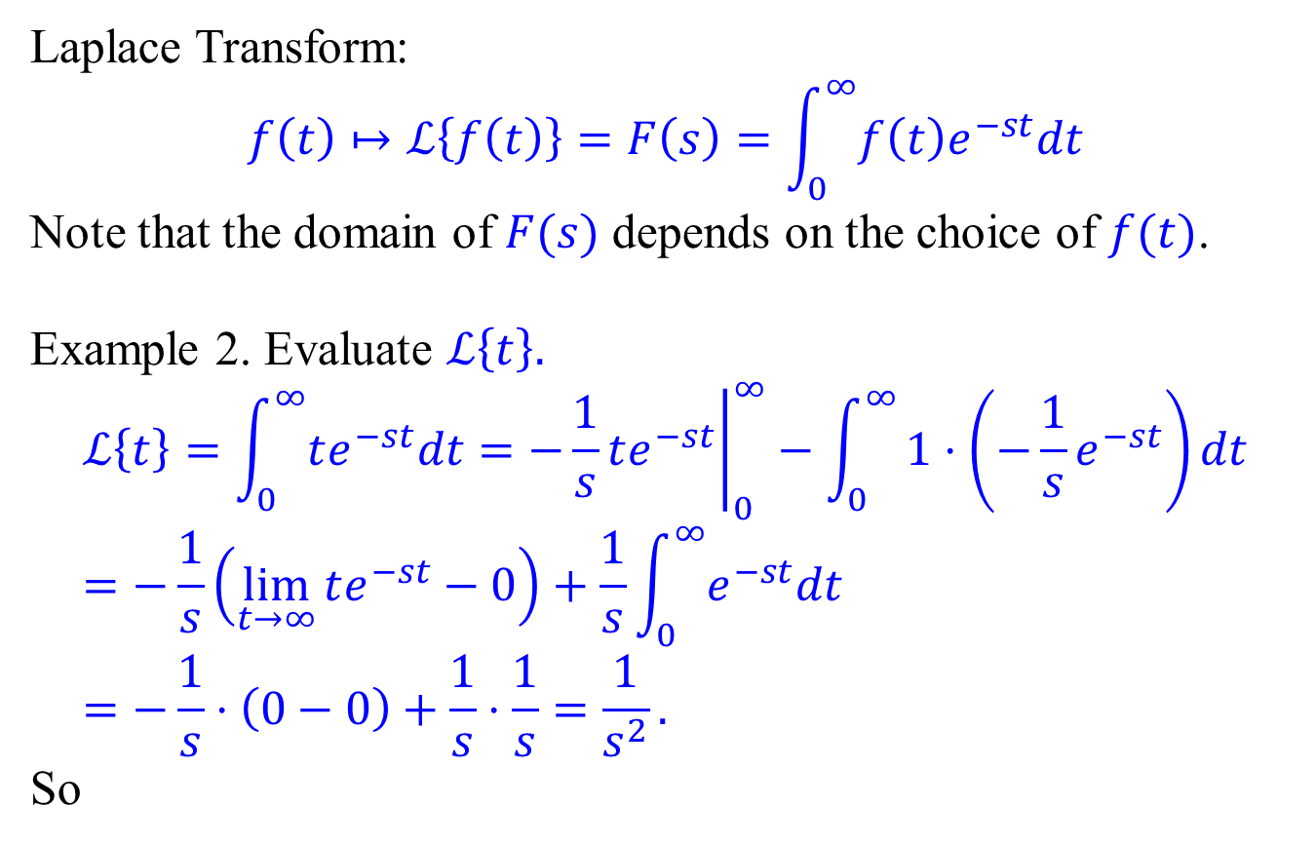

Examples of Laplace transforms
Laplace Transform:
$$f\left(t\right)↦ℒ\left\{f\left(t\right)\right\}=F\left(s\right)=\int_{0}^{∞}{f\left(t\right)e^{−st}dt}$$
Note that the domain of $F(s)$ depends on the choice of $f(t)$.
Example 2. Evaluate $ℒ\left\{t\right\}.$
$$ℒ\left\{t\right\}=\int_{0}^{∞}{te^{−st}dt}={\left.−\frac{1}{s}te^{−st}\right|}_{0}^{∞}−\int_{0}^{∞}{1⋅\left(−\frac{1}{s}e^{−st}\right)dt} \\ =−\frac{1}{s}\left(\lim_{t→∞}{te^{−st}}−0\right)+\frac{1}{s}\int_{0}^{∞}{e^{−st}dt} \\ =−\frac{1}{s}⋅\left(0−0\right)+\frac{1}{s}⋅\frac{1}{s}=\frac{1}{s^{2}}.$$
So
$$ℒ\left\{t\right\}=\frac{1}{s^{2}}, s>0$$

Slide 9
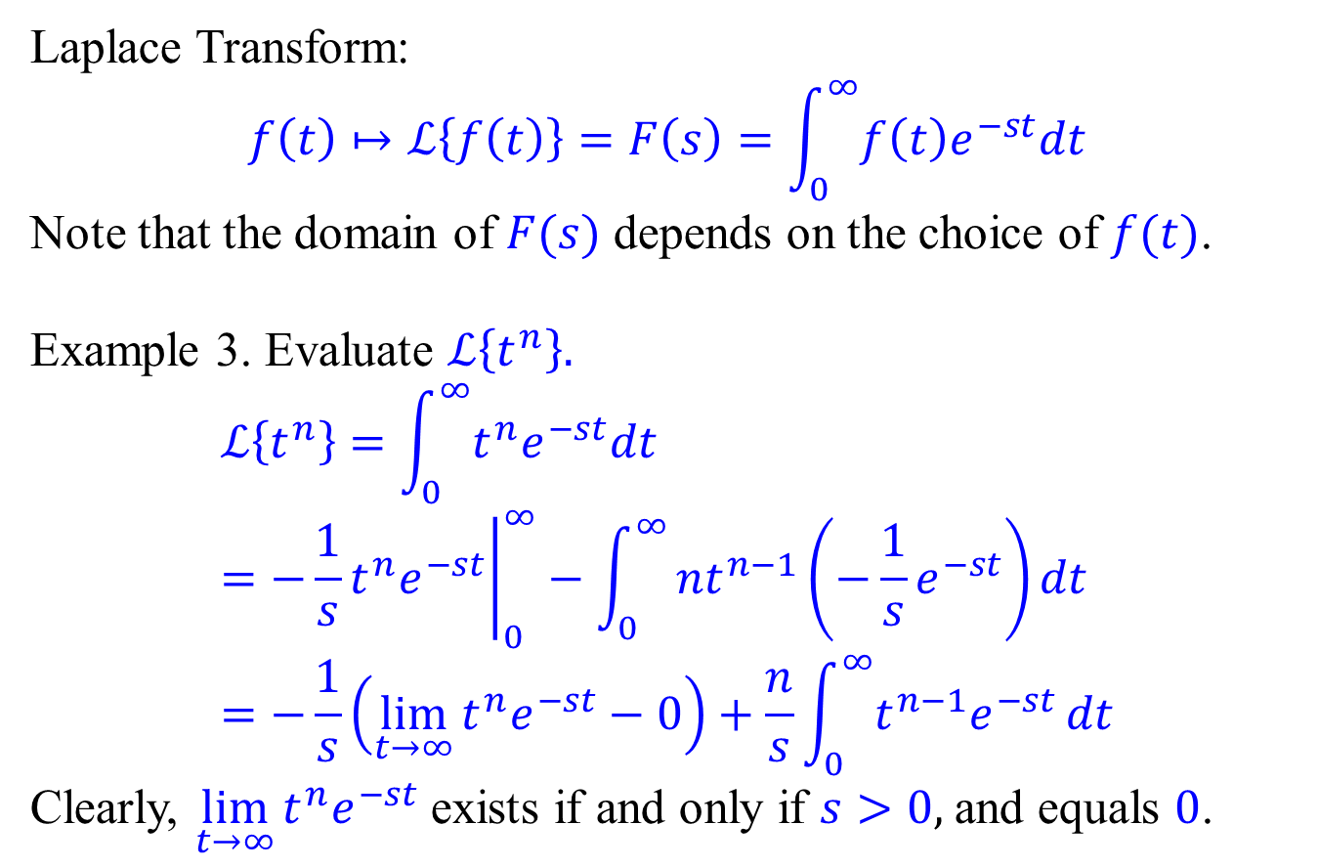
Examples of Laplace transforms
Laplace Transform:
$$f\left(t\right)↦ℒ\left\{f\left(t\right)\right\}=F\left(s\right)=\int_{0}^{∞}{f\left(t\right)e^{−st}dt}$$
Note that the domain of $F(s)$ depends on the choice of $f(t)$.
Example 3. Evaluate $ℒ\left\{t^{n}\right\}.$
$$ℒ\left\{t^{n}\right\}=\int_{0}^{∞}{t^{n}e^{−st}dt}={\left.−\frac{1}{s}t^{n}e^{−st}\right|}_{0}^{∞}−\int_{0}^{∞}{nt^{n−1}\left(−\frac{1}{s}e^{−st}\right)dt} \\ =−\frac{1}{s}\left(\lim_{t→∞}{t^{n}e^{−st}}−0\right)+\frac{n}{s}\int_{0}^{∞}{t^{n−1}e^{−st}}dt$$
Clearly, $\lim_{t→∞}{t^{n}e^{−st}}$ exists if and only if $s>0$, and equals 0.

Slide 10
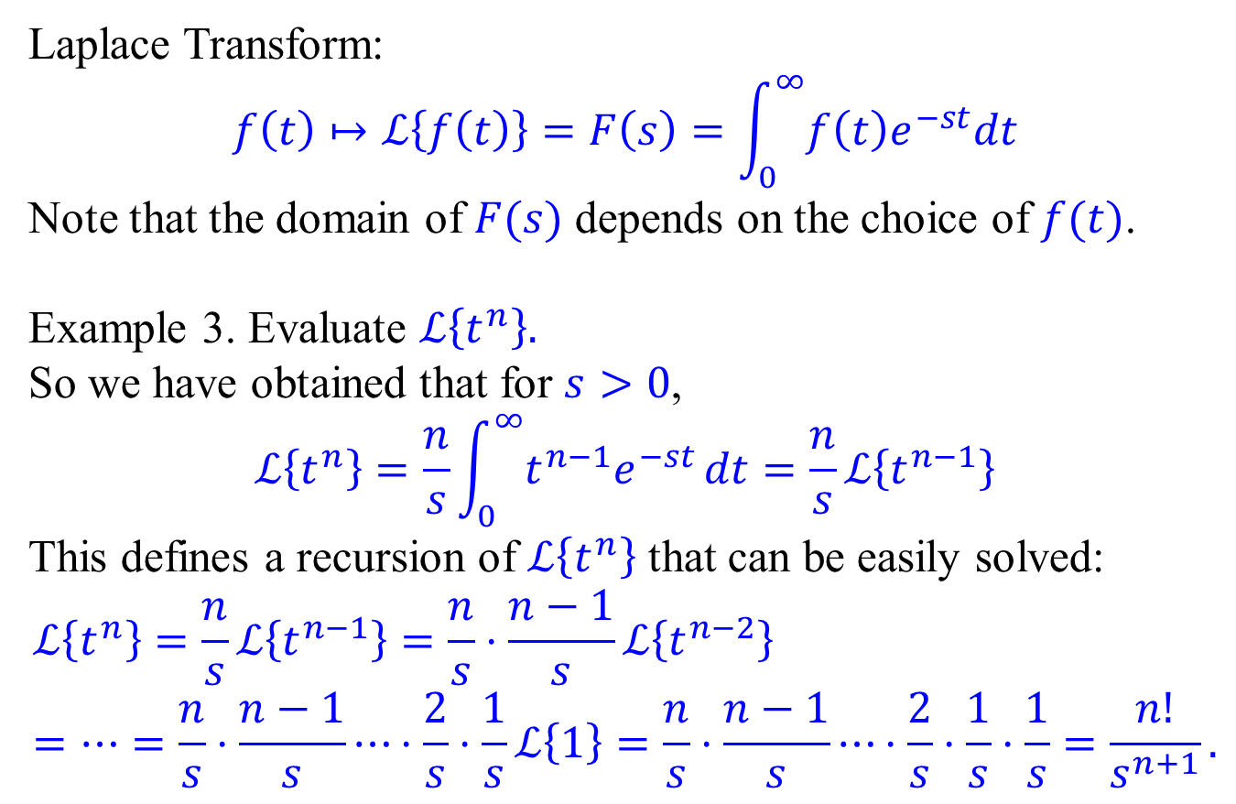
Examples of Laplace transforms
Laplace Transform:
$$f\left(t\right)↦ℒ\left\{f\left(t\right)\right\}=F\left(s\right)=\int_{0}^{∞}{f\left(t\right)e^{−st}dt}$$
Note that the domain of $F(s)$ depends on the choice of $f(t)$.
Example 3. Evaluate $ℒ\left\{t^{n}\right\}.$
So we have obtained that for $s>0$,
$$ℒ\left\{t^{n}\right\}=\frac{n}{s}\int_{0}^{∞}{t^{n−1}e^{−st}}dt=\frac{n}{s}ℒ\left\{t^{n−1}\right\}$$
This defines a recursion of $ℒ\left\{t^{n}\right\}$ that can be easily solved:
$$ℒ\left\{t^{n}\right\}=\frac{n}{s}ℒ\left\{t^{n−1}\right\}=\frac{n}{s}⋅\frac{n−1}{s}ℒ\left\{t^{n−2}\right\} \\ =⋯=\frac{n}{s}⋅\frac{n−1}{s}⋯⋅\frac{2}{s}⋅\frac{1}{s}ℒ\left\{1\right\}=\frac{n}{s}⋅\frac{n−1}{s}⋯⋅\frac{2}{s}⋅\frac{1}{s}⋅\frac{1}{s}=\frac{n!}{s^{n+1}}.$$

Slide 11
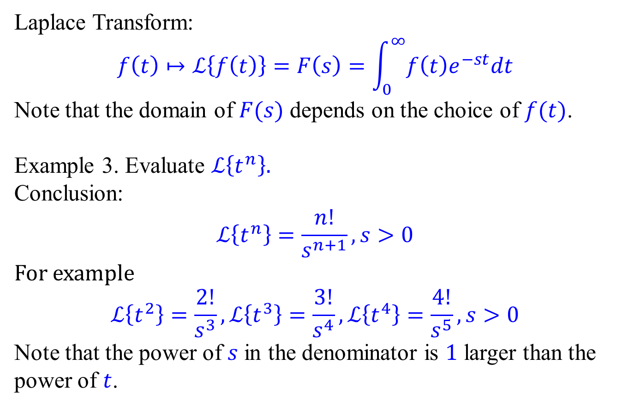
Examples of Laplace transforms
Laplace Transform:
$$f\left(t\right)↦ℒ\left\{f\left(t\right)\right\}=F\left(s\right)=\int_{0}^{∞}{f\left(t\right)e^{−st}dt}$$
Note that the domain of $F(s)$ depends on the choice of $f(t)$.
Example 3. Evaluate $ℒ\left\{t^{n}\right\}.$
Conclusion:
$$ℒ\left\{t^{n}\right\}=\frac{n!}{s^{n+1}}, s>0$$
For example
$$ℒ\left\{t^{2}\right\}=\frac{2!}{s^{3}},ℒ\left\{t^{3}\right\}=\frac{3!}{s^{4}},ℒ\left\{t^{4}\right\}=\frac{4!}{s^{5}},s>0$$
Note that the power of $s$ in the denominator is 1 larger than the power of $t$.

Slide 12
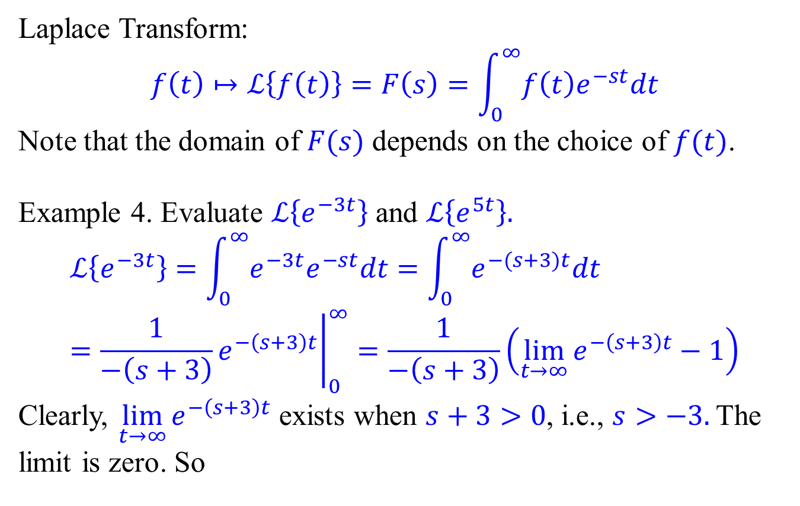
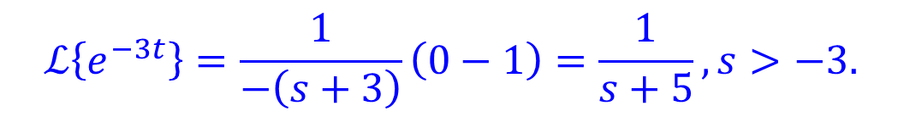
Examples of Laplace transforms
Laplace Transform:
$$f\left(t\right)↦ℒ\left\{f\left(t\right)\right\}=F\left(s\right)=\int_{0}^{∞}{f\left(t\right)e^{−st}dt}$$
Note that the domain of $F(s)$ depends on the choice of $f(t)$.
Example 4. Evaluate $ℒ\left\{e^{−3t}\right\}$ and $ℒ\left\{e^{5t}\right\}.$
$$ℒ\left\{e^{−3t}\right\}=\int_{0}^{∞}{e^{−3t}e^{−st}dt}=\int_{0}^{∞}{e^{−(s+3)t}dt}={\left.\frac{1}{−\left(s+3\right)}e^{−\left(s+3\right)t}\right|}_{0}^{∞}=\frac{1}{−\left(s+3\right)}\left(\lim_{t→∞}{e^{−\left(s+3\right)t}}−1\right)$$
Clearly, $\lim_{t→∞}{e^{−\left(s+3\right)t}}$ exists when $s+3>0$, i.e., $s>−3.$The limit is zero. So
$$ℒ\left\{e^{−3t}\right\}=\frac{1}{−\left(s+3\right)}\left(0−1\right)=\frac{1}{s+5},s>−3.$$

Slide 13
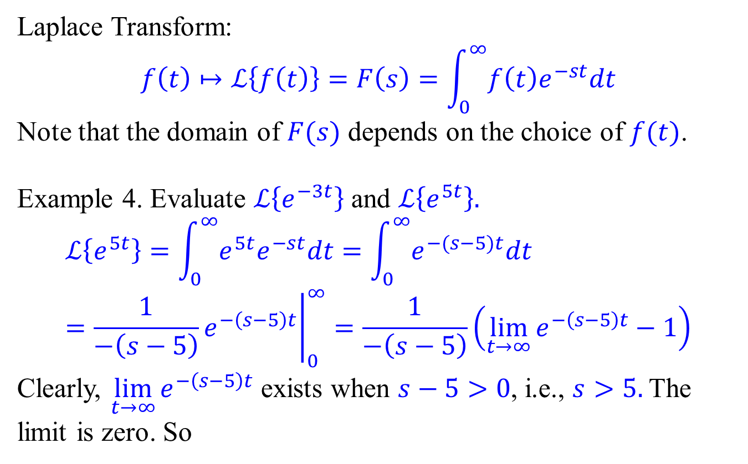
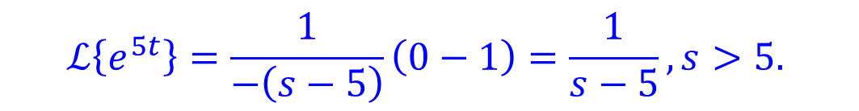
Examples of Laplace transforms
Laplace Transform:
$$f\left(t\right)↦ℒ\left\{f\left(t\right)\right\}=F\left(s\right)=\int_{0}^{∞}{f\left(t\right)e^{−st}dt}$$
Note that the domain of $F(s)$ depends on the choice of $f(t)$.
Example 4. Evaluate $ℒ\left\{e^{−3t}\right\}$ and $ℒ\left\{e^{5t}\right\}.$
$$ℒ\left\{e^{5t}\right\}=\int_{0}^{∞}{e^{5t}e^{−st}dt}=\int_{0}^{∞}{e^{−(s−5)t}dt}={\left.\frac{1}{−\left(s−5\right)}e^{−\left(s−5\right)t}\right|}_{0}^{∞}=\frac{1}{−\left(s−5\right)}\left(\lim_{t→∞}{e^{−\left(s−5\right)t}}−1\right)$$
Clearly, $\lim_{t→∞}{e^{−\left(s−5\right)t}}$ exists when $s−5>0$, i.e., $s>5.$The limit is zero. So
$$ℒ\left\{e^{5t}\right\}=\frac{1}{−\left(s−5\right)}\left(0−1\right)=\frac{1}{s−5},s>5.$$

Slide 14
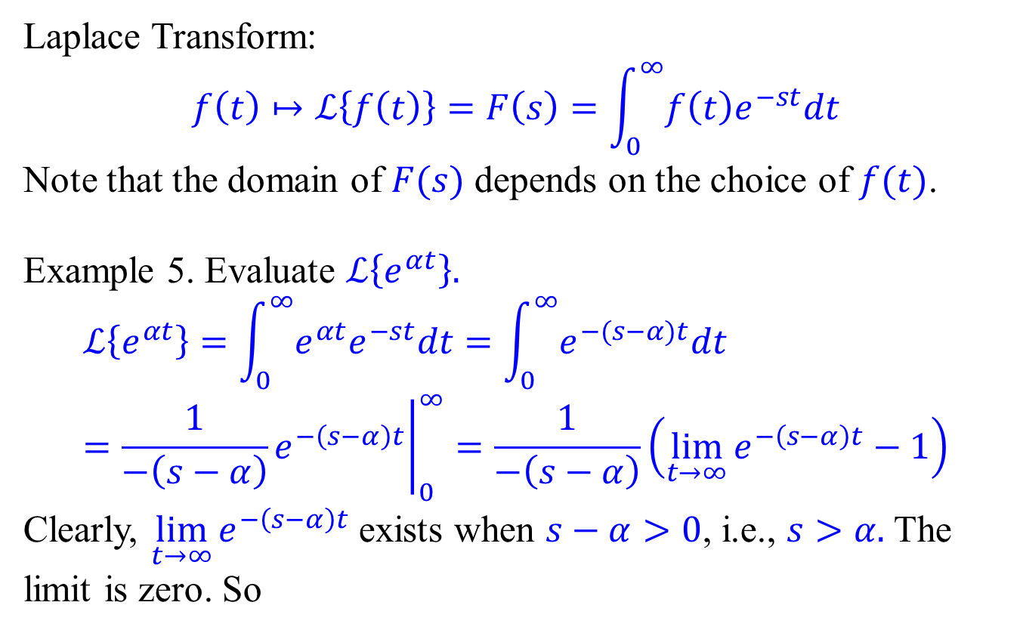

Examples of Laplace transforms
Laplace Transform:
$$f\left(t\right)↦ℒ\left\{f\left(t\right)\right\}=F\left(s\right)=\int_{0}^{∞}{f\left(t\right)e^{−st}dt}$$
Note that the domain of $F(s)$ depends on the choice of $f(t)$.
Example 5. Evaluate $ℒ\left\{e^{αt}\right\}.$
$$ℒ\left\{e^{αt}\right\}=\int_{0}^{∞}{e^{αt}e^{−st}dt}=\int_{0}^{∞}{e^{−(s−α)t}dt}={\left.\frac{1}{−\left(s−α\right)}e^{−\left(s−α\right)t}\right|}_{0}^{∞}=\frac{1}{−\left(s−α\right)}\left(\lim_{t→∞}{e^{−\left(s−α\right)t}}−1\right)$$
Clearly, $\lim_{t→∞}{e^{−\left(s−α\right)t}}$ exists when $s−α>0$, i.e., $s>α.$The limit is zero. So
$$ℒ\left\{e^{αt}\right\}=\frac{1}{s−α},s>α.$$

Slide 15
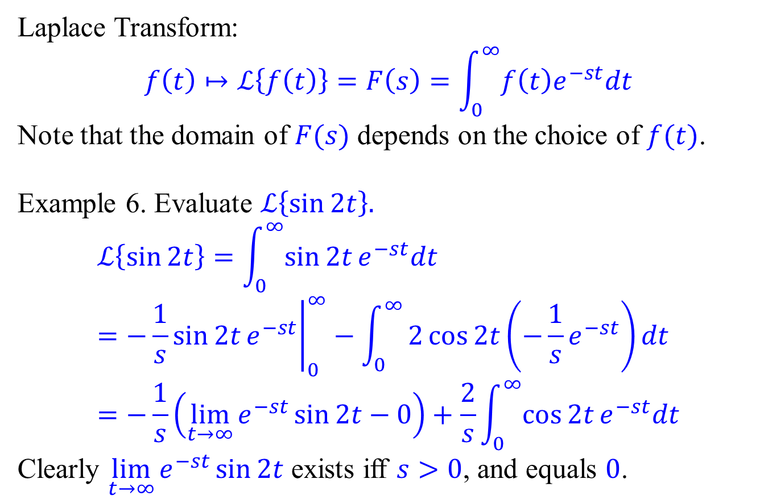
Examples of Laplace transforms
Laplace Transform:
$$f\left(t\right)↦ℒ\left\{f\left(t\right)\right\}=F\left(s\right)=\int_{0}^{∞}{f\left(t\right)e^{−st}dt}$$
Note that the domain of $F(s)$ depends on the choice of $f(t)$.
Example 6. Evaluate $ℒ\left\{\sin{2t}\right\}.$
$$ℒ\left\{\sin{2t}\right\}=\int_{0}^{∞}{\sin{2t}e^{−st}dt} \\ ={\left.−\frac{1}{s}\sin{2t}e^{−st}\right|}_{0}^{∞}−\int_{0}^{∞}{2\cos{2t}\left(−\frac{1}{s}e^{−st}\right)dt} \\ =−\frac{1}{s}\left(\lim_{t→∞}{e^{−st}\sin{2t}}−0\right)+\frac{2}{s}\int_{0}^{∞}{\cos{2t}e^{−st}dt}$$
Clearly $\lim_{t→∞}{e^{−st}\sin{2t}}$ exists iff $s>0$, and equals 0.

Slide 16
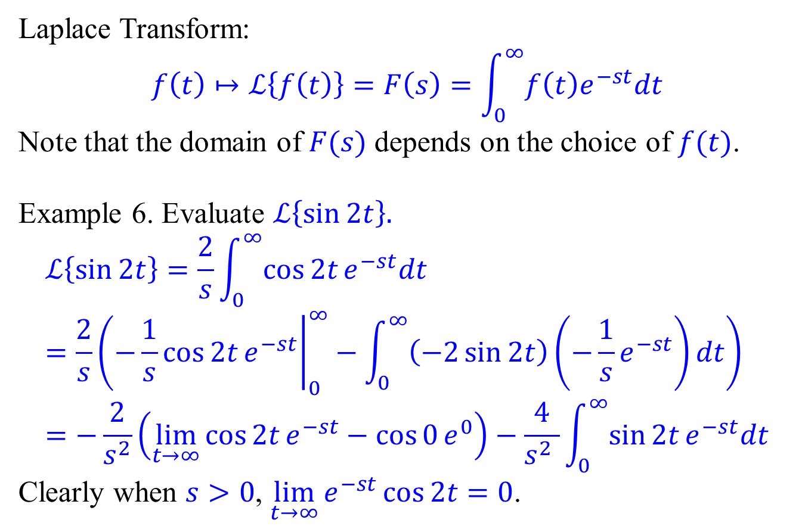
Examples of Laplace transforms
Laplace Transform:
$$f\left(t\right)↦ℒ\left\{f\left(t\right)\right\}=F\left(s\right)=\int_{0}^{∞}{f\left(t\right)e^{−st}dt}$$
Note that the domain of $F(s)$ depends on the choice of $f(t)$.
Example 6. Evaluate $ℒ\left\{\sin{2t}\right\}.$
$$ℒ\left\{\sin{2t}\right\}=\frac{2}{s}\int_{0}^{∞}{\cos{2t}e^{−st}dt} \\ =\frac{2}{s}\left({\left.−\frac{1}{s}\cos{2t}e^{−st}\right|}_{0}^{∞}−\int_{0}^{∞}{\left(−2\sin{2t}\right)\left(−\frac{1}{s}e^{−st}\right)dt}\right) \\ =−\frac{2}{s^{2}}\left(\lim_{t→∞}{\cos{2t}e^{−st}}−\cos{0}e^{0}\right)−\frac{4}{s^{2} }\int_{0}^{∞}{\sin{2t}e^{−st}dt}$$
Clearly when $s>0$, $\lim_{t→∞}{e^{−st}\cos{2t}}=0$.

Slide 17
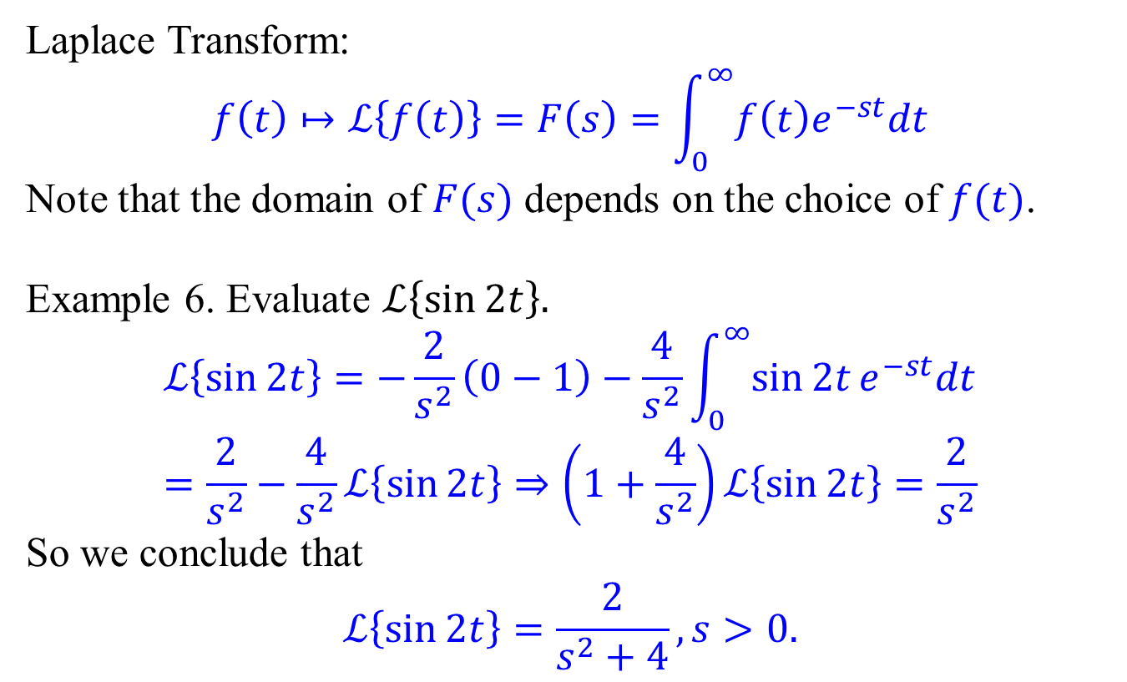
Examples of Laplace transforms
Laplace Transform:
$$f\left(t\right)↦ℒ\left\{f\left(t\right)\right\}=F\left(s\right)=\int_{0}^{∞}{f\left(t\right)e^{−st}dt}$$
Note that the domain of $F(s)$ depends on the choice of $f(t)$.
Example 6. Evaluate $ℒ\left\{\sin{2t}\right\}.$
$$ℒ\left\{\sin{2t}\right\}=−\frac{2}{s^{2}}\left(0−1\right)−\frac{4}{s^{2}}\int_{0}^{∞}{\sin{2t}e^{−st}dt} \\ =\frac{2}{s^{2}}−\frac{4}{s^{2}}ℒ\left\{\sin{2t}\right\}⇒\left(1+\frac{4}{s^{2}}\right)ℒ\left\{\sin{2t}\right\}=\frac{2}{s^{2}}$$
So we conclude that
$$ℒ\left\{\sin{2t}\right\}=\frac{2}{s^{2}+4}, s>0.$$

Slide 18
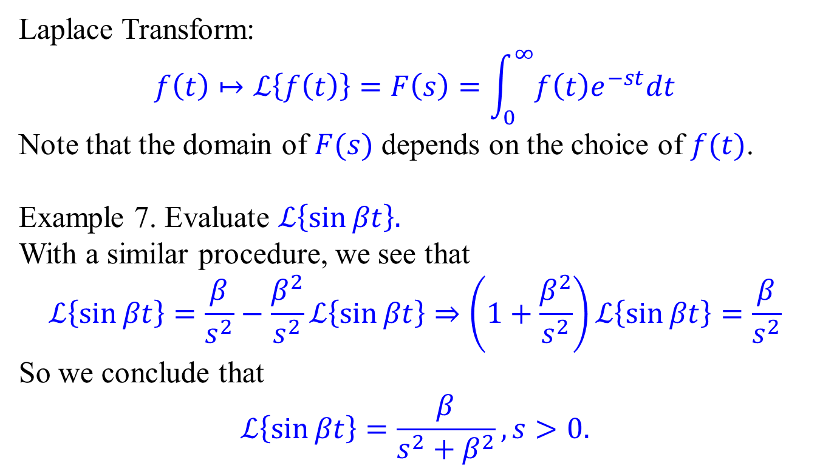
Examples of Laplace transforms
Laplace Transform:
$$f\left(t\right)↦ℒ\left\{f\left(t\right)\right\}=F\left(s\right)=\int_{0}^{∞}{f\left(t\right)e^{−st}dt}$$
Note that the domain of $F(s)$ depends on the choice of $f(t)$.
Example 7. Evaluate $ℒ\left\{\sin{βt}\right\}.$
With a similar procedure, we see that
$$ℒ\left\{\sin{βt}\right\}=\frac{β}{s^{2}}−\frac{β^{2}}{s^{2}}ℒ\left\{\sin{βt}\right\}⇒\left(1+\frac{β^{2}}{s^{2}}\right)ℒ\left\{\sin{βt}\right\}=\frac{β}{s^{2}}$$
So we conclude that
$$ℒ\left\{\sin{βt}\right\}=\frac{β}{s^{2}+β^{2}}, s>0.$$

Slide 19
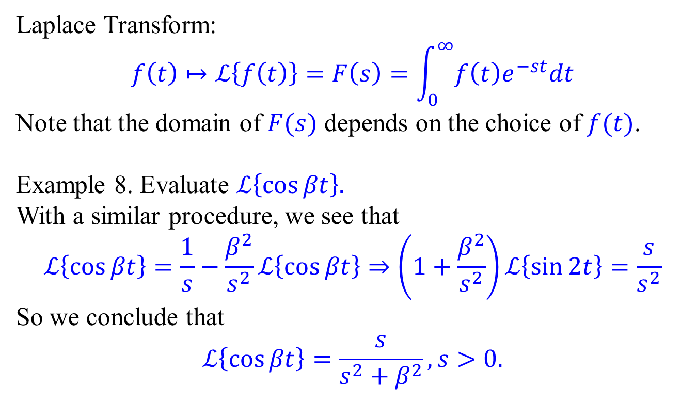
Examples of Laplace transforms
Laplace Transform:
$$f\left(t\right)↦ℒ\left\{f\left(t\right)\right\}=F\left(s\right)=\int_{0}^{∞}{f\left(t\right)e^{−st}dt}$$
Note that the domain of $F(s)$ depends on the choice of $f(t)$.
Example 8. Evaluate $ℒ\left\{\cos{βt}\right\}.$
With a similar procedure, we see that
$$ℒ\left\{\cos{βt}\right\}=\frac{1}{s}−\frac{β^{2}}{s^{2}}ℒ\left\{\cos{βt}\right\}⇒\left(1+\frac{β^{2}}{s^{2}}\right)ℒ\left\{\sin{2t}\right\}=\frac{s}{s^{2}}$$
So we conclude that
$$ℒ\left\{\cos{βt}\right\}=\frac{s}{s^{2}+β^{2}}, s>0.$$

Slide 20
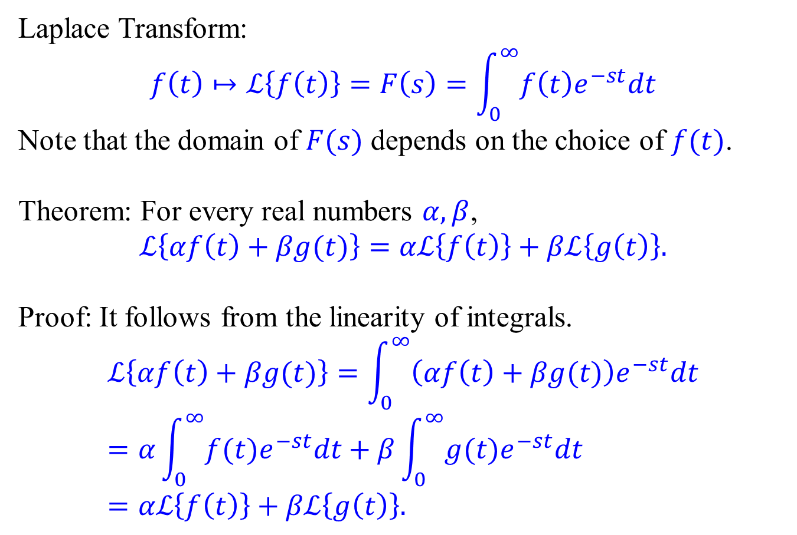
Linearity of Laplace transform
Laplace Transform:
$$f\left(t\right)↦ℒ\left\{f\left(t\right)\right\}=F\left(s\right)=\int_{0}^{∞}{f\left(t\right)e^{−st}dt}$$
Note that the domain of $F(s)$ depends on the choice of $f(t)$.
Theorem: For every real numbers $α, β$,
$$ℒ\left\{αf\left(t\right)+βg(t)\right\}=αℒ\left\{f\left(t\right)\right\}+βℒ\left\{g\left(t\right)\right\}.$$
Proof: It follows from the linearity of integrals.
$$ℒ\left\{αf\left(t\right)+βg(t)\right\}=\int_{0}^{∞}{\left(αf\left(t\right)+βg(t)\right)e^{−st}dt} \\ =α\int_{0}^{∞}{f(t)e^{−st}dt}+β\int_{0}^{∞}{g(t)e^{−st}dt}=αℒ\left\{f\left(t\right)\right\}+βℒ\left\{g\left(t\right)\right\}.$$

Slide 21
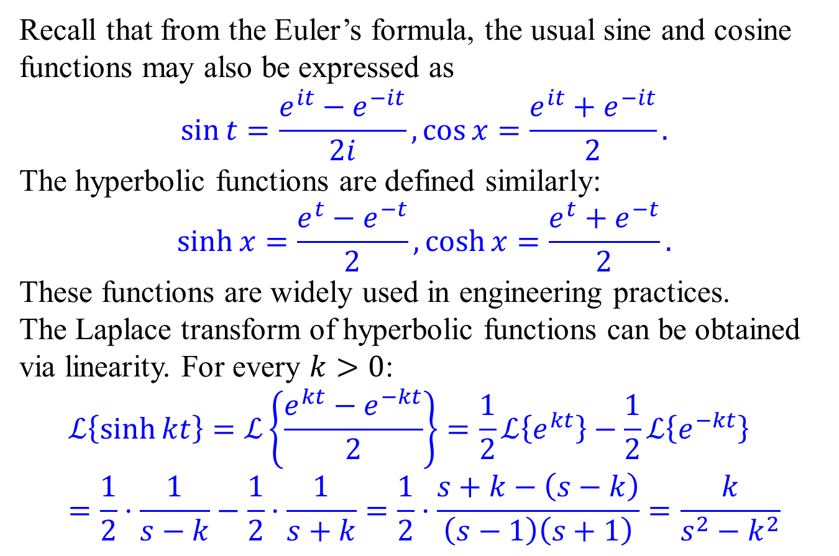
Hyperbolic functions
Recall that from the Euler’s formula, the usual sine and cosine functions may also be expressed as
$$\sin{t}=\frac{e^{it}−e^{−it}}{2i},\cos{x}=\frac{e^{it}+e^{−it}}{2}.$$
The hyperbolic functions are defined similarly:
$$\sinh{x}=\frac{e^{t}−e^{−t}}{2},\cosh{x}=\frac{e^{t}+e^{−t}}{2}.$$
These functions are widely used in engineering practices.
The Laplace transform of hyperbolic functions can be obtained via linearity. For every $k>0$:
$$ℒ\left\{\sinh{kt}\right\}=ℒ\left\{\frac{e^{kt}−e^{−kt}}{2}\right\}=\frac{1}{2}ℒ\left\{e^{kt}\right\}−\frac{1}{2}ℒ\left\{e^{−kt}\right\} \\ =\frac{1}{2}⋅\frac{1}{s−k}−\frac{1}{2}⋅\frac{1}{s+k}=\frac{1}{2}⋅\frac{s+k−\left(s−k\right)}{\left(s−1\right)\left(s+1\right)}=\frac{k}{s^{2}−k^{2}}$$

Slide 22
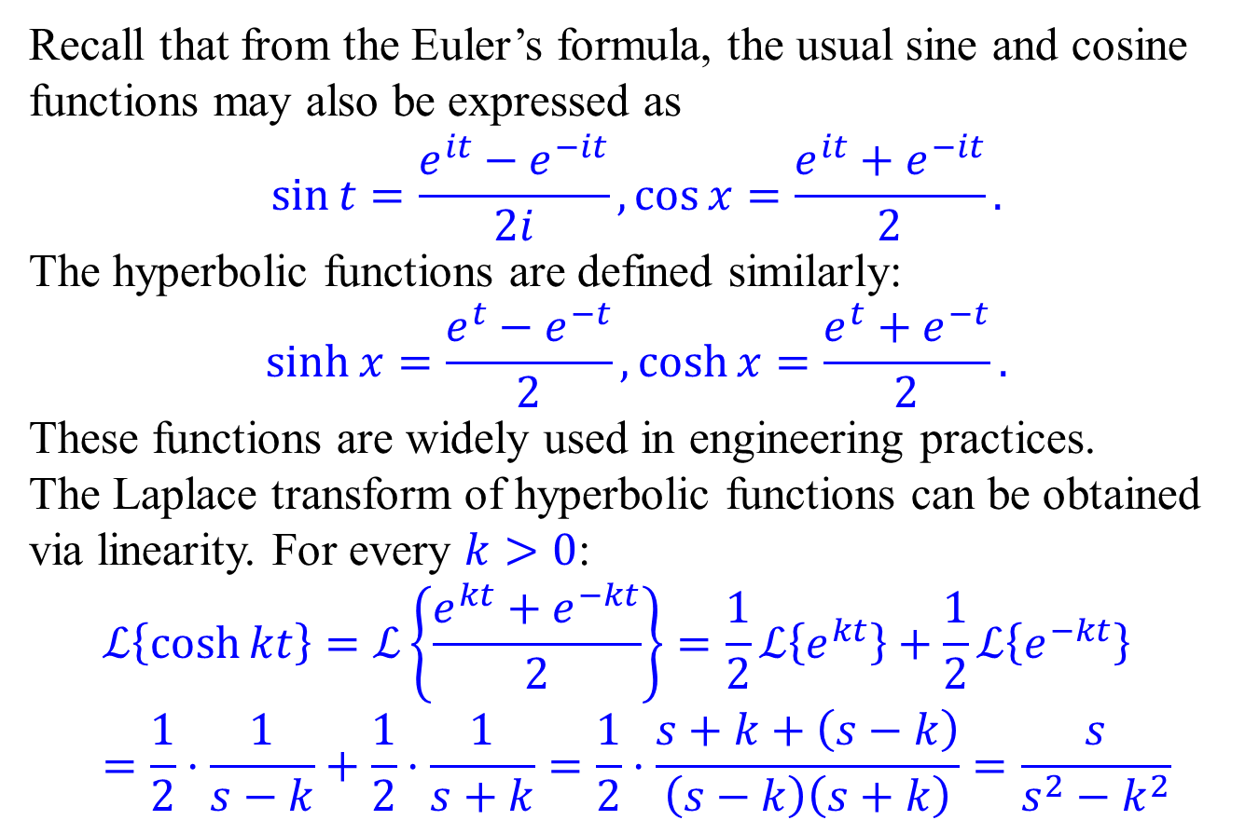
Hyperbolic functions
Recall that from the Euler’s formula, the usual sine and cosine functions may also be expressed as
$$\sin{t}=\frac{e^{it}−e^{−it}}{2i},\cos{x}=\frac{e^{it}+e^{−it}}{2}.$$
The hyperbolic functions are defined similarly:
$$\sinh{x}=\frac{e^{t}−e^{−t}}{2},\cosh{x}=\frac{e^{t}+e^{−t}}{2}.$$
These functions are widely used in engineering practices.
The Laplace transform of hyperbolic functions can be obtained via linearity. For every $k>0$:
$$ℒ\left\{\cosh{kt}\right\}=ℒ\left\{\frac{e^{kt}+e^{−kt}}{2}\right\}=\frac{1}{2}ℒ\left\{e^{kt}\right\}+\frac{1}{2}ℒ\left\{e^{−kt}\right\} \\ =\frac{1}{2}⋅\frac{1}{s−k}+\frac{1}{2}⋅\frac{1}{s+k}=\frac{1}{2}⋅\frac{s+k+\left(s−k\right)}{\left(s−k\right)\left(s+k\right)}=\frac{s}{s^{2}−k^{2}}$$

Slide 23
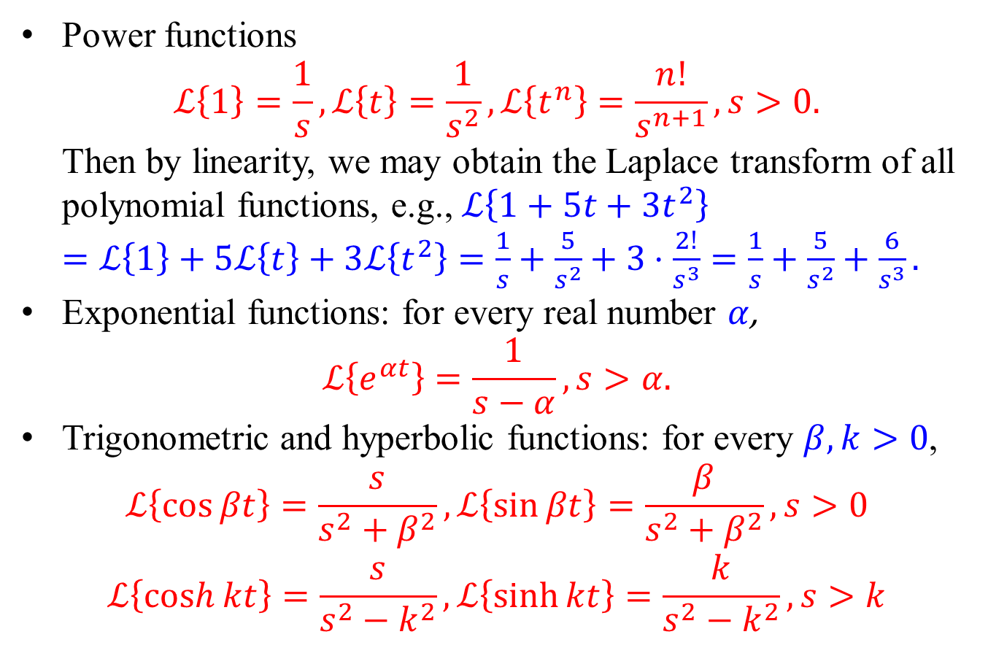
Summary of basic formulas for Laplace transform
Power functions $ℒ\left\{1\right\}=\frac{1}{s}, ℒ\left\{t\right\}=\frac{1}{s^{2}}, ℒ\left\{t^{n}\right\}=\frac{n!}{s^{n+1}}, s>0.$ Then by linearity, we may obtain the Laplace transform of all polynomial functions, e.g., $ℒ\left\{1+5t+3t^{2}\right\}$ $=ℒ\left\{1\right\}+5ℒ\left\{t\right\}+3ℒ\left\{t^{2}\right\}=\frac{1}{s}+\frac{5}{s^{2}}+3⋅\frac{2!}{s^{3}}=\frac{1}{s}+\frac{5}{s^{2}}+\frac{6}{s^{3}}.$
Exponential functions: for every real number $α$, $ℒ\left\{e^{αt}\right\}=\frac{1}{s−α}, s>α.$
Trigonometric and hyperbolic functions: for every $β,k>0$,
$$ℒ\left\{\cos{βt}\right\}=\frac{s}{s^{2}+β^{2}}, ℒ\left\{\sin{βt}\right\}=\frac{β}{s^{2}+β^{2}}, s>0$$
$$ℒ\left\{\cosh{kt}\right\}=\frac{s}{s^{2}−k^{2}}, ℒ\left\{\sinh{kt}\right\}=\frac{k}{s^{2}−k^{2}}, s>k$$

